Slide 1
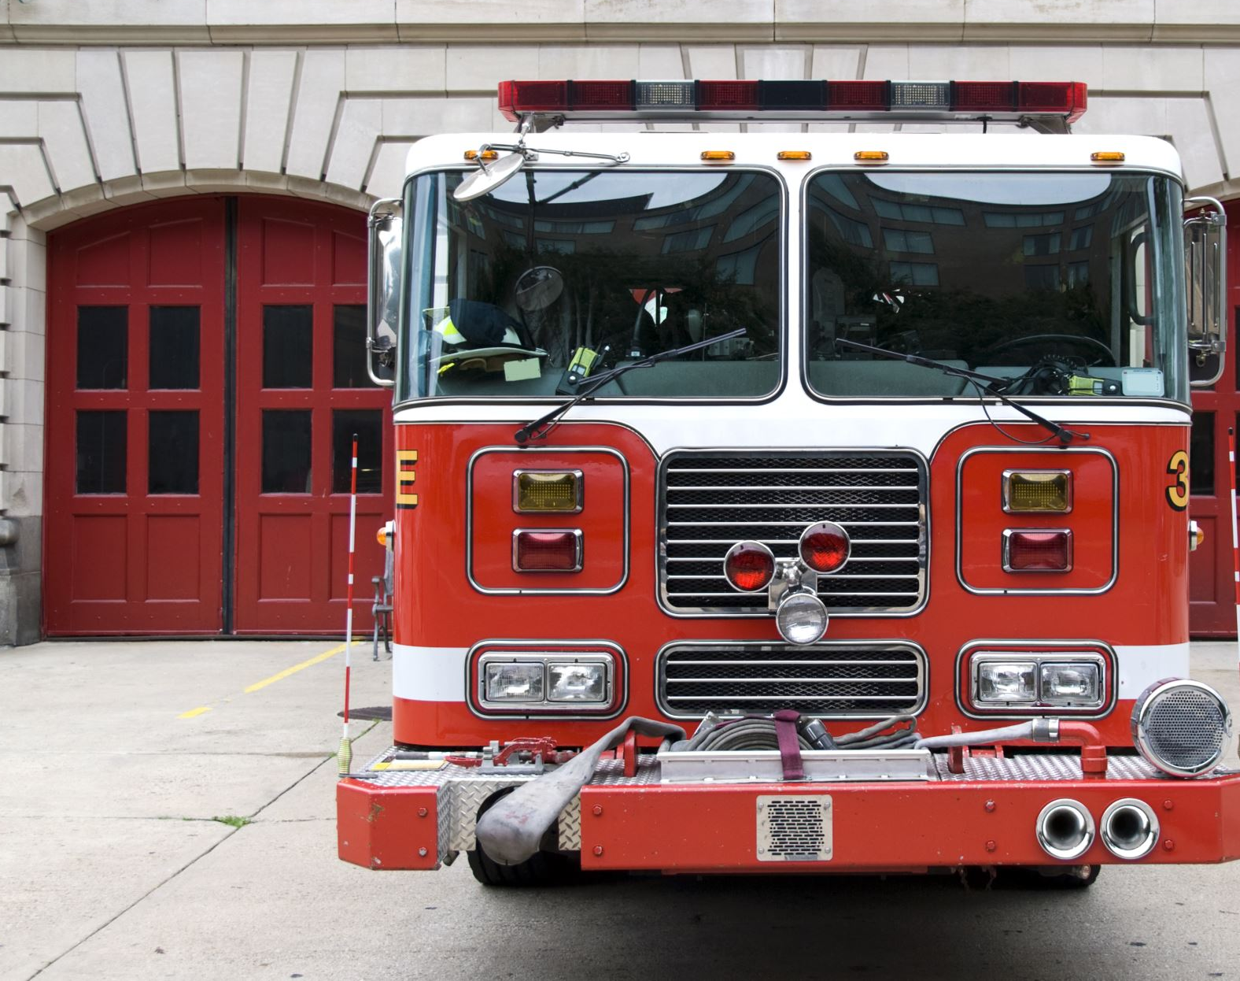
Emergency Management
Bushfires

Slide 2

Project Overview
Delivering a web application to determine :
What areas are going to affect if the bushfire happens in given location?
Building blocks: Strategy(objectives defined, documented and communicated), processes(roles and responsibilities and flexibility within project), people(good balance of skill levels), Decisions(combination of logical and creative thinking) and Risks(potential risks mitigation by immediate actions)
Methods: Data sourcing, Data cleaning, Data visualization, prediction and web application.
Technologies and software used: python, R programming for data cleaning, Angular JS for web application. Tableau for visualization.
Max Time Limit : 1 minute

Slide 3

Deliverables of the Overall Project
Predictions on fire prone areas and notification of fire brigadier
Responsibilities were divided into teams: each method is handled by each team of 3 to 4 members and possible interchange in each of them
Sourcing(available data sets of prone areas and weather)
Research,
Web application(angular Js,
Visualization(tableau)
Product backlog:
New features in web application
Analysis of data
Predictions
Technology selection
Max Time Limit : 2 minutes

Slide 4
Slide 3: Deliverables of this iteration
Revising the artifacts on previous project
Upskilling on the technologies which are indeed required
Building a prototype on web application to show case how the application would be like and possible feedbacks to get it on full-fledged level.
Knowledge sharing on Technology
Max Time Limit : 1 minute

Slide 5
Tasks Completed in this Iteration
Data Sourcing
The data sourcing has been done by each team member in the team. As the project revolves around Australian Bushfires , hence the data-set required to build a web application is huge. Most of the resources have been from different data-sets available on internet . NASA's unclassified data has been used as one of the source for the data required for this project.
Data Cleaning
Data Cleaning has been performed by Nithin Reddy Gundre, Bala Tharun Reddy, Varsha Shankar and Vijay Bathini. These members have detected incorrect or corrupt data and have deleted/cleansed it from the relevant data. The data of other countries has been removed as well for more accuracy of data-set.
Max Time Limit : 8 minutes (for all the demo slides)

Slide 6
Tasks Completed in this Iteration
Below is the link of the tasks completed by Nithin Reddy Gundre :
https://teams.microsoft.com/l/file/B91940EC-7055-4241-9365-850DF4AE9AD8?tenantId=d02378ec-1688-46d5-8540-1c28b5f470f6&fileType=docx&objectUrl=https%3A%2F%2Fdeakin365.sharepoint.com%2Fsites%2FData2IntelligenceConsulting%2FShared%20Documents%2FD2I%20(Emergency%20Management)%2FNithin%2FProof_of_Work.docx&baseUrl=https%3A%2F%2Fdeakin365.sharepoint.com%2Fsites%2FData2IntelligenceConsulting&serviceName=teams&threadId=19:5e24cce19aaa43a4b4f31094a2cc040d@thread.tacv2&groupId=10567a03-e6be-45e6-b917-f7b8920e9c9b
Max Time Limit : 8 minutes (for all the demo slides)

Slide 7
Tasks Completed in this Iteration
Below is the link of the tasks completed by Mohan Kiran Bandaru :
https://teams.microsoft.com/l/file/4B50CCAD-B975-4C68-BA3F-4AF33ED9113C?tenantId=d02378ec-1688-46d5-8540-1c28b5f470f6&fileType=docx&objectUrl=https%3A%2F%2Fdeakin365.sharepoint.com%2Fsites%2FData2IntelligenceConsulting%2FShared%20Documents%2FD2I%20(Emergency%20Management)%2FMohan%2Ftableau%20visualisation.docx&baseUrl=https%3A%2F%2Fdeakin365.sharepoint.com%2Fsites%2FData2IntelligenceConsulting&serviceName=teams&threadId=19:5e24cce19aaa43a4b4f31094a2cc040d@thread.tacv2&groupId=10567a03-e6be-45e6-b917-f7b8920e9c9b
Max Time Limit : 8 minutes (for all the demo slides)

Slide 8
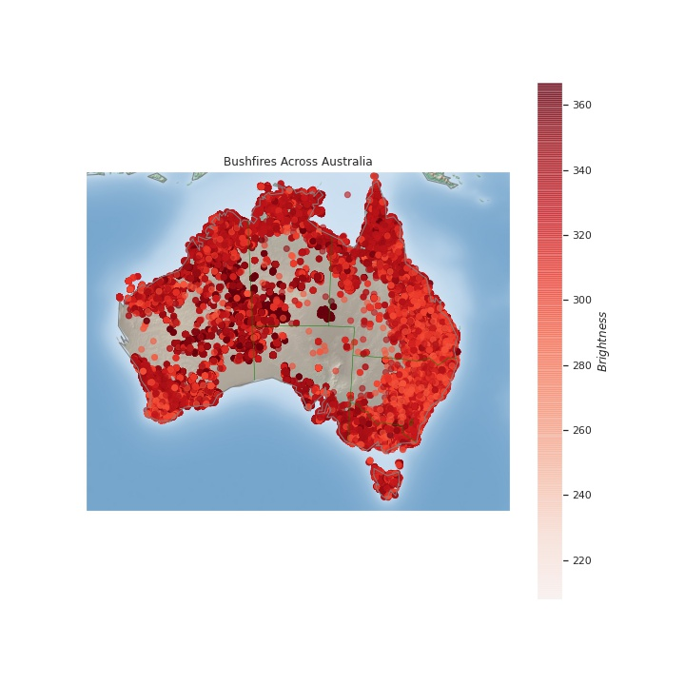
Tasks Completed in this Iteration
Heat Maps to analyze the data by Aiswarya Subrahmanian :
Max Time Limit : 8 minutes (for all the demo slides)

Slide 9
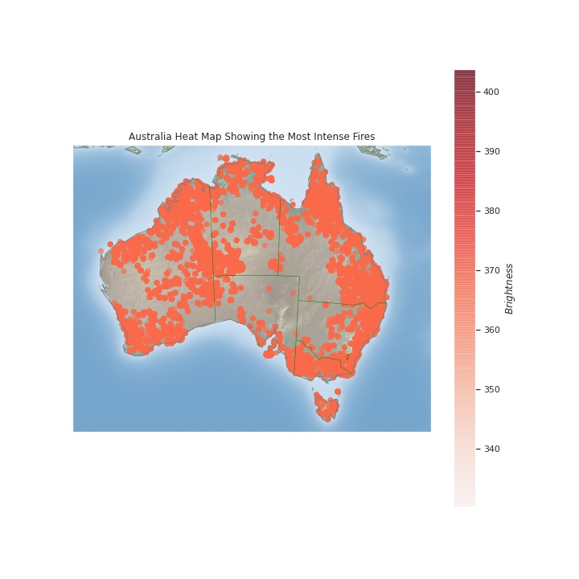
Tasks Completed in this Iteration
Heat Maps to analyze the data by Aiswarya Subrahmanian :
Max Time Limit : 8 minutes (for all the demo slides)

Slide 10
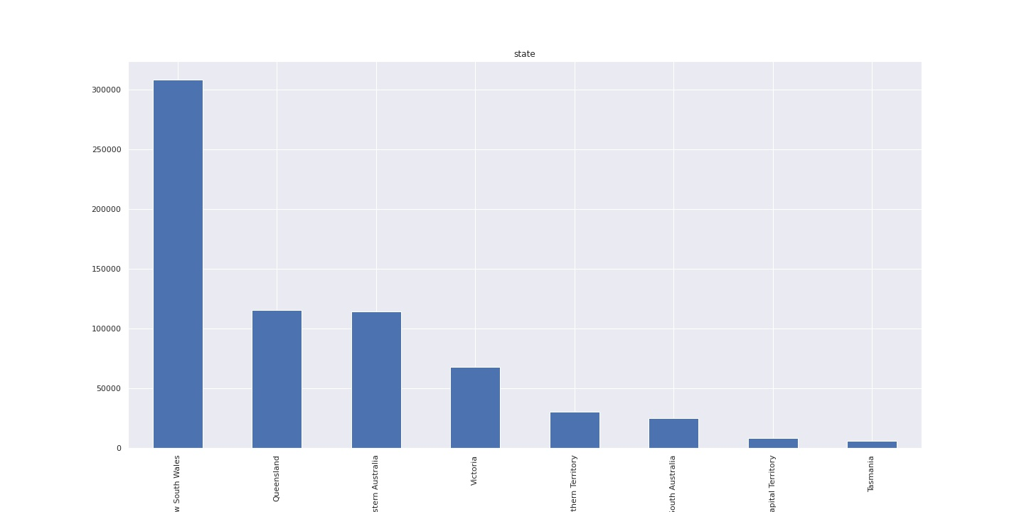
Tasks Completed in this Iteration
Graphs plotted to analyze the data by Aiswarya Subrahmanian :
Max Time Limit : 8 minutes (for all the demo slides)

Slide 11
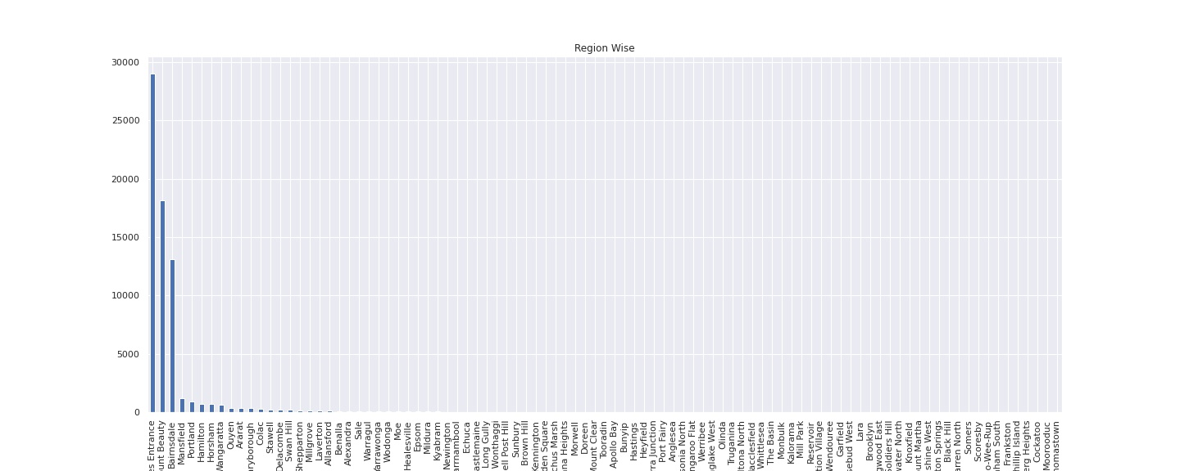
Tasks Completed in this Iteration
Graphs plotted to analyze the data by Aiswarya Subrahmanian :
Max Time Limit : 8 minutes (for all the demo slides)

Slide 12
Team Contribution
Team Member | Major Contribution | Hours Recorded
Nithin Reddy Gundre | Data Sourcing for bushfire, weather data collection for 4 months, visualization using python time series, reverse geo location, preparing document for UI prototype, documenting all the work done by me | 39 Hours
Mohan Kiran Bandaru | Visualization using Tableau and Python(time series for Canberra) Data sourcing for bushfire locations Documentation and it is showcased in folder "Mohan" | 41.5 hours
Hamza Zulfiqar | Data extraction for the bushfires, got familiar with python for my part in Iteration 2, learnt how to plot graphs and visualize data in python | 25.33 hours
Shikhar Dhyani | Data sourcing, documentation of presentations, upskilling in python, using python to create graphs for data analysis in iteration 2 | 35. 3 hours
Vijay Bathini | Data sourcing, prepared presentations and Data cleaning | 50
Nikita Shishupal Dighe
Aiswarya Subrahmanian | Data sourcing for bushfire and weather data. Created heat maps for data. Did reverse geocoding for the bushfire data. | 55
Max Time Limit : 1 minute
The squad worklog should be open for the panel to check

Slide 13
Team Contribution
Team Member | Major Contribution | Hours Recorded
Bala Tharun Reddy Shyamala | Data Sourcing for Bushfire, Data Cleaning, extraction of weather data in respective with the bushfire locations | 52 hours
Nikhil Reddy Viraati
Pavan Kumar Vadla
Piyush Gandhi | Data Sourcing, Analyzing and Visualizing Ambulance Victoria data, Predicting Emergency Demands in Victoria | 55 hours
Simran Rashpal Dhillon
Varsha Shankar
The squad worklog should be open for the panel to check
Max Time Limit : 1 minute

Slide 14
Plan for the next iteration
The data analysis must be the focus of the next iteration to predict the desired outcome .
The analysis of location-based data to determine Fire Brigadiers closest to the affected location.
Analysis of weather-based data to determine which areas the most endangered.
Analysis of the data we get from Bureau of Meteorology in the coming days..
Max Time Limit : 2 minutes

Slide 15
Discussions with Higher Distinction and Distinction Students
Max Time Limit : 5 minutes

Slide 16
General Discussions
Max Time Limit : 10 minutes

